Slide 1
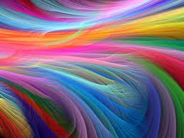
Inside the mirror of my mind
By Stephanie Shawn
Period 1
ELA/ Tech
October 17, 2011

Slide 2
Abstract to Concrete
Summer is…
Warm nights under the stars
Dripping popsicles
Sand in my toes
TT in the freezer

Slide 3
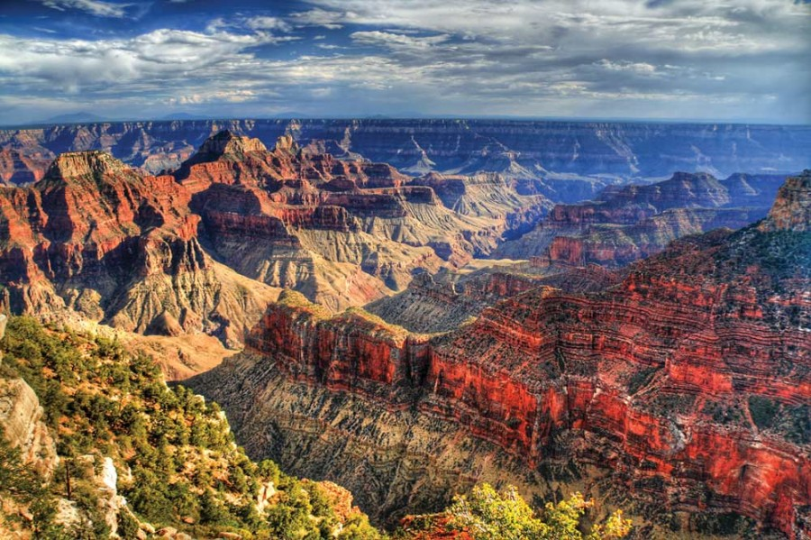
Abstract to Concrete
Love is…
Opening your heart as wide as the Grand Canyon
Crossing the universe to hug
Bringing sweets
Writing a thoughtful card

Slide 4
I Am From
I am from teachers and teachers and more teachers;
The projects and ideas and tireless performance of a teacher,
Like a quiet activist, coming in to fight in the trenches.
I am from teachers,
Their, “Learn this, and you can do that!”
Anything is possible, endless limitation.
I am from making poets out of 11 year olds,
And revealing my inner-life to them.
I am from, “Don’t do that, and spit out your gum, and you can’t go to the bathroom, and you can’t call him that, put your middle finger down, I will not accept that behavior”--- intermittent stare down---- “ I care so much it hurts” every day.

Slide 5
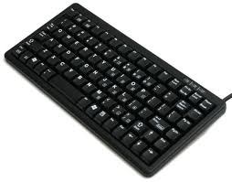
I Am From
I am from believing in community so hard it hurts.
From caring so deep it hurts.
From “Ms. Shawn, my finger, it hurts!”
I am from typing 115 words per minute,
To my mom who hears me a totally different way others hear me.
I am from you, and your look, and your demeanor, and feeling inner-connections with most everyone.

Slide 6
I Am From
I am from, “Stars like diamonds” and “Hate like Homophobia.”
Or “The diamonds in the sky.”
I am from KCRW, KPFK, Democracy Now, and Morning Becomes Eclectic,
Tea, and ½ coffee ½ milk, and sugar at 11.
I am from projector in my eyes, a constant desire to post posters, and deathly faces of boredom.
I am from wanting to express everything I feel about people or life to people.

Slide 7
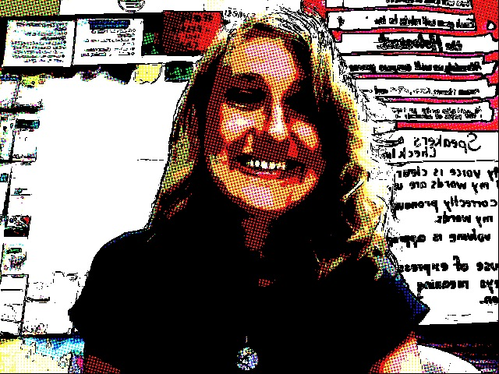
I Am From
I am from every culture of food ever available to me.
I am from poetry and fiction, history and math,
Piano and singing and a crazy love of karaoke.
I am from the earth and adventuring to places unheard of.
I am from love, crossing lines of realization and believing in myself.

